Slide 1

Ecommerce Recommender System
Group 3
1.Lynn Achieng
2.Josephine Maro
3.Edmund Nyaribo
4.Troye Gilbert
5.Pascalia Maiga

Slide 2
02
01
03
Business Understanding
Data Understanding
Data Preparation
TABLE OF CONTENTS
04
05
06
Deployment
Modelling
Evaluation
CRISP-DM Roadmap
This project was carried out using the CRISP-dm methodology

Slide 3
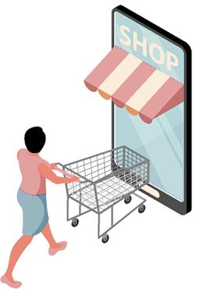
Business Understanding
The project aims to develop a recommender that provides personalized product recommendations to online shoppers. With the vast array of choices on platforms like Amazon and Jumia, consumers often find it overwhelming to make quick decisions. This recommender will simplify the shopping experience by analyzing user preferences and suggesting the best products based on their specifications. The goal is to enhance customer satisfaction, reduce decision-making time, and increase sales for businesses by offering tailored recommendations that meet the users' needs efficiently. This solution addresses the common issue of choice overload in online shopping.

Slide 4
Objectives
The goal is to Develop a recommendation system that provides accurate and relevant personalized product suggestions based on user specs, enhancing online shopping by simplifying decisions and boosting customer satisfaction. The model will help users make informed decisions when selecting products by considering their preferences and constraints.

Slide 5
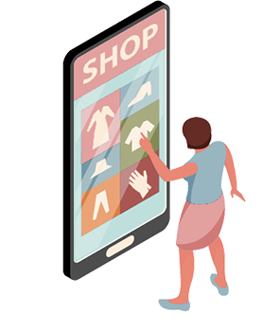
Data Understanding
We sourced for data by web scraping using scrapy through Flipkart “https://www.flipkart.com/” to details about the products they do sell. Scrapy was used to do the scrapping. The data we scrapped contained about 12041 rows and 12 columns. We then looked for an additional dataset of mobile phones from the same website and it contained 3114 rows and 8 columns. We then combined these two datasets and used them in our project.

Slide 6
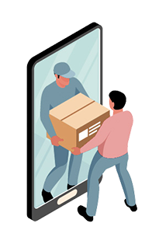
Data Preparation
We identified specific columns out of 15 that were relevant to the dataset.
Formatting included merging the two datasets making sure there are no conflicts between the columns, renaming the columns to fit our preferences.
Cleaning involved removing missing values in the dataset and in other cases filling using back filling and forward filling techniques.
We conducted some EDA that yielded us some domain knowledge we could use to inform future steps and modelling. Some of the plots we came up with are shown in the next slides:

Slide 7
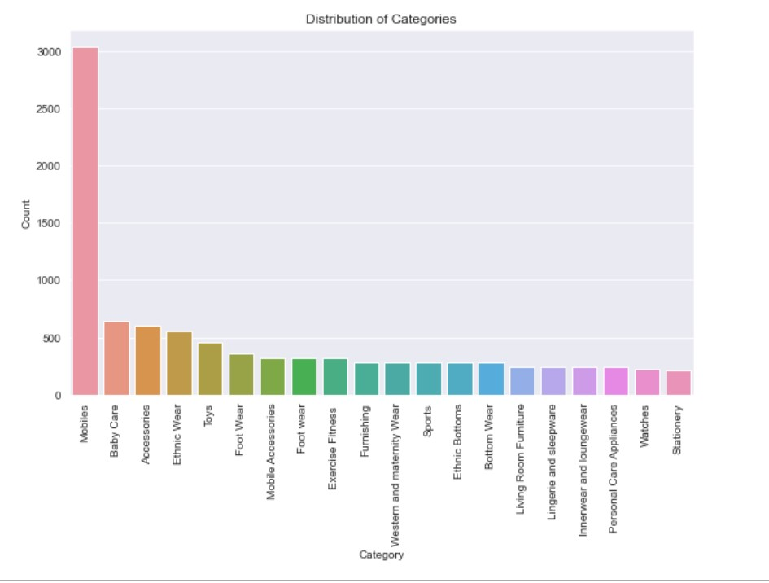
Category Distribution
By the count of each category we constructed a count plot.

Slide 8
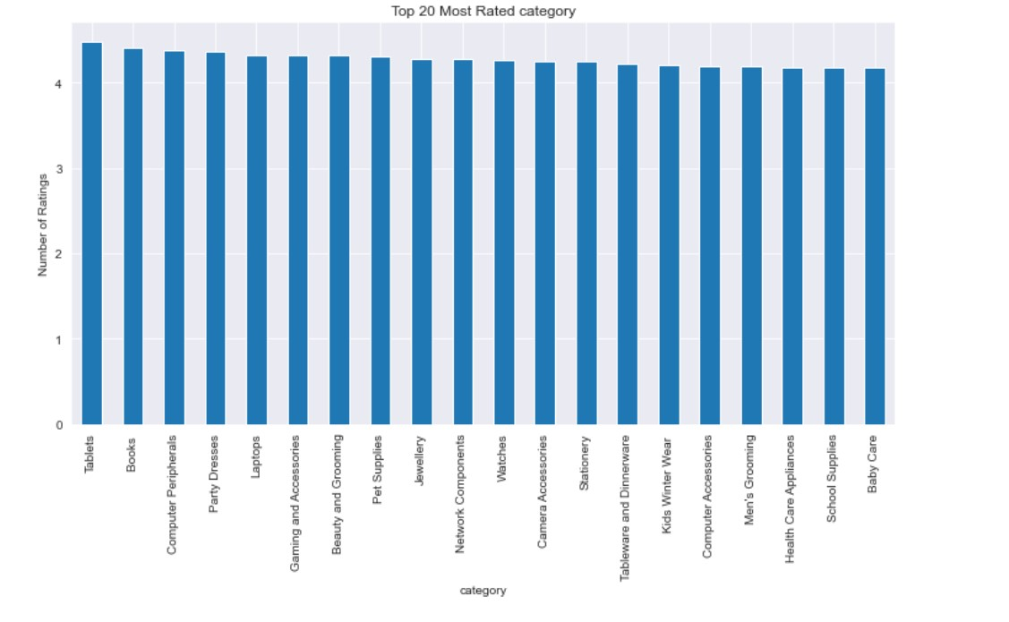
Category Ratings
Using the ratings column, we did plot a bar plot showing the most rated products

Slide 9
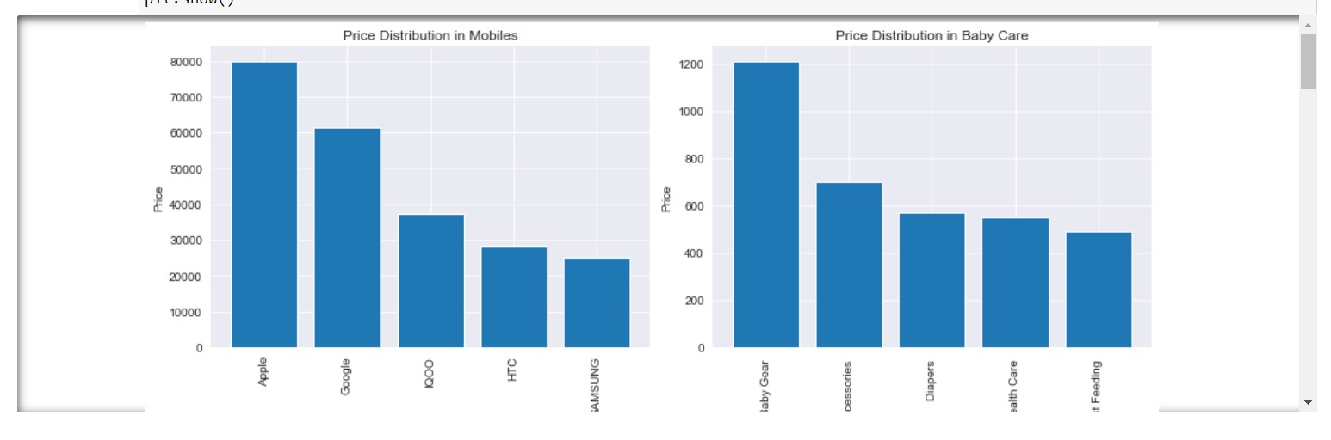
Category Price Distribution
With the price column we were also able to plot the distribution of prices in different categories.

Slide 10
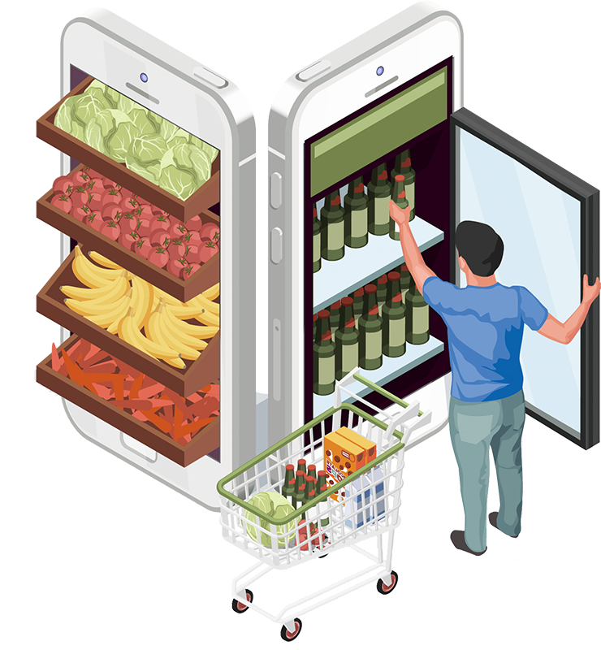
Modelling
In this section, we built classification models using
1. SVDpp (Singular Value Decomposition Plus Plus)
2. SVD(Singular Value Decomposition)
3. KNNWithMeans
4. Baseline Model / KNNBasic
The best performing ones were tuned and ensembled to produce one model however this did not exhibit better performance. Further scaling of the dataset was done and cross validation included to improve the accuracy score

Slide 11
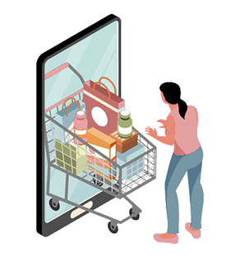
UI and Deployment
Deployment
UI
The UI was built using Django is a high-level Python web framework
The Deployment was done using Railway, this is after integrating the web server with PostgreSQL

Slide 12

Recommendations
Comprehensive Product Coverage
Real-Time Data Integration
Ensuring that the ecommerce recommender system covers a wide range of products, both popular and off-the-beaten-products, to cater to diverse customer preferences.
Integrating real-time data sources, such as new coming products to offer up- to-date and relevant recommendations to users.

Slide 13

Conclusions
Products Diversity
Continuous Improvement
Personalized Experiences
By showcasing lesser- known products, the recommender can encourage users to explore new products, diversifying ecommerce and distributing user specifications more evenly.
By analyzing user feedback and product purchase patterns, the system continually learns and improves its recommendations, enhancing the overall purchase experience for users
The ecommerce recommender system offers tailored recommendations, enabling users to discover products and experiences that align with their interests and specifications.

Slide 14
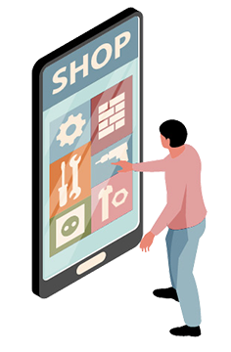
Thanks!
Do you have any questions?

